Slide 1


CASE IT UP
(PURCHASING PHONE CASES APP)
By: Alapide, Rhea Mae D.
Cacao, Bience Nico H.
Garcia, Carlo
Reyes, Allen Francis Z.
Villanueva, Meryll Denise C.
Final Project in IT-331
Application Development and Immerging Technologies
Mr. Erwin Enriquez

Slide 2

PRODUCT DESCRIPTION
Phone cases around the world have played an important part in protecting smartphones from unnecessary damages throughout its usage. It keeps phones look new as long as possible, and it increases the lifespan of the smartphone. However, phone cases tend to have a uniform design that bores the users in many places, and in order to address that issue, the team aims to design and develop a mobile application that would allow users to design the phone cases according to their preferences.

Slide 3
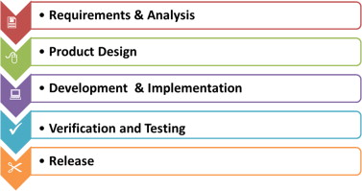
TRADITIONAL WATERFALL MODEL

Slide 4
WATERFALL MODEL
Waterfall development approaches utilize a progressive design process. The objectives and architecture of a program are determined before any coding is begun, which is an advantage of this model. This implies that tools, functionality, and methodologies are thoroughly planned and thought through prior to the beginning of the implementation phase.

Slide 5
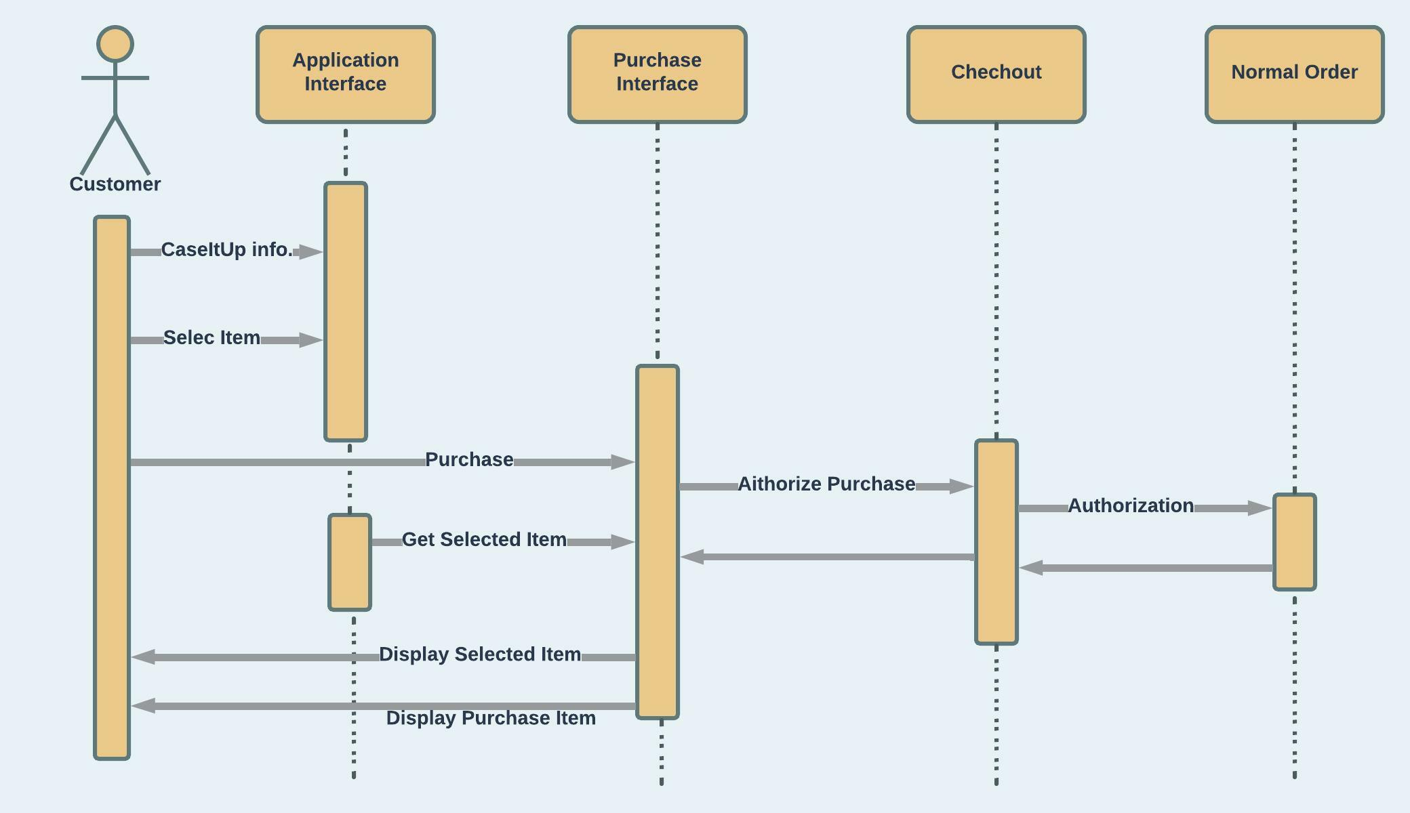
SYSTEM ARCHITECTURE,
Sequence Diagram

Slide 6
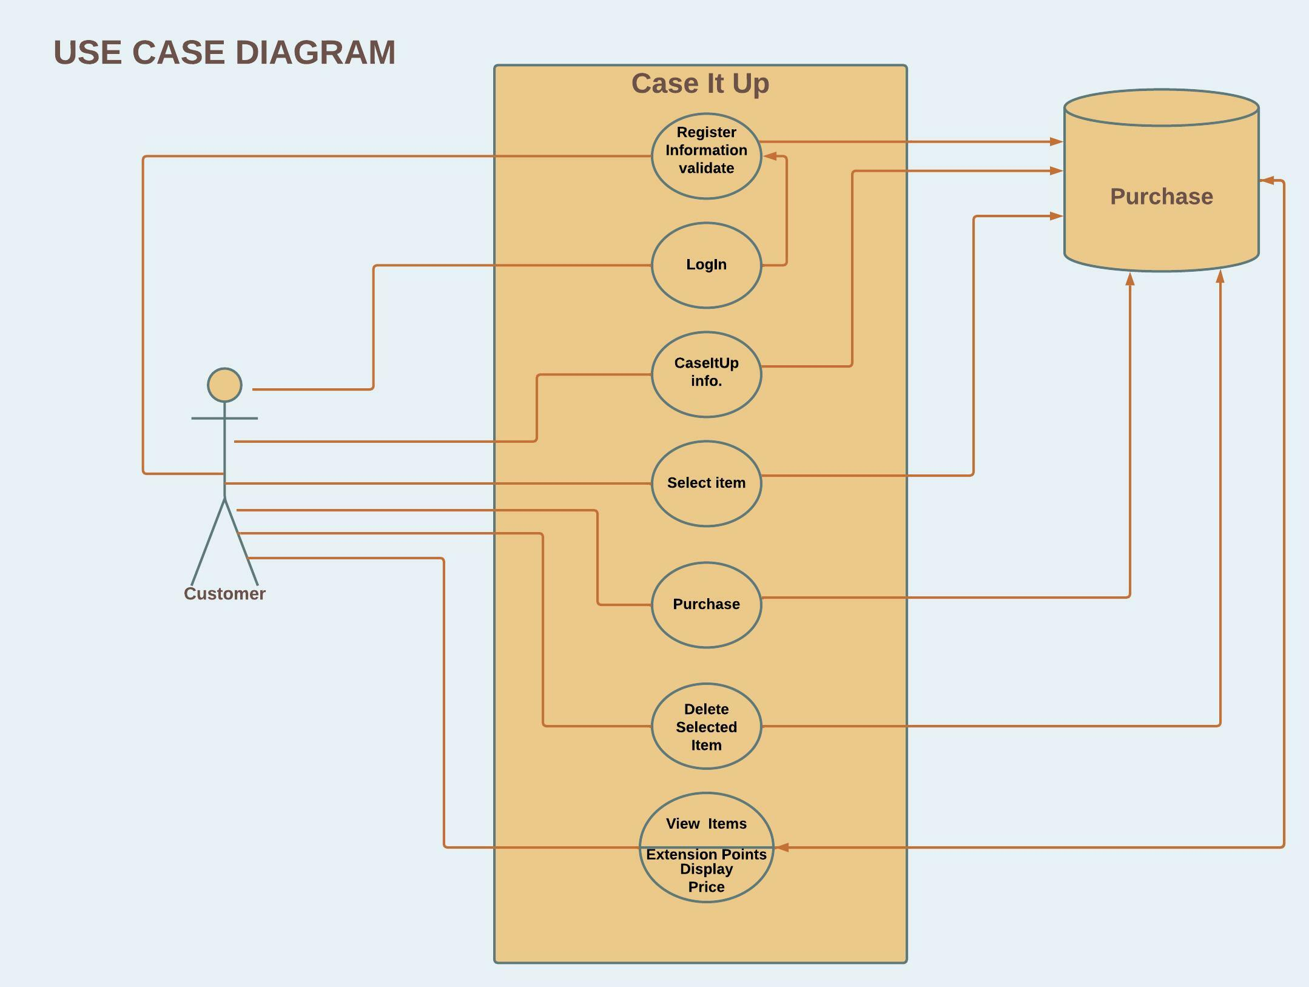
SYSTEM ARCHITECTURE

Slide 7

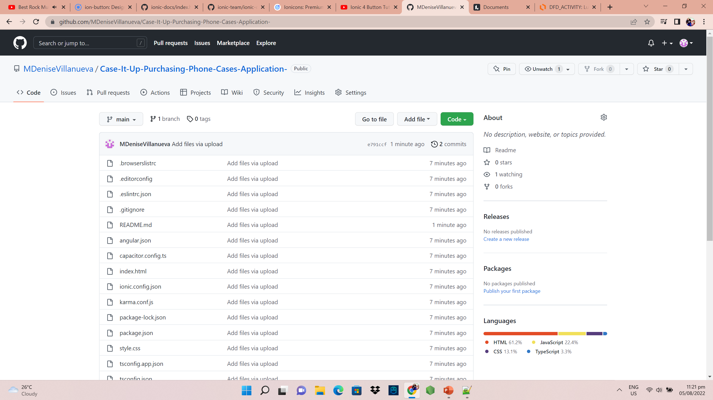
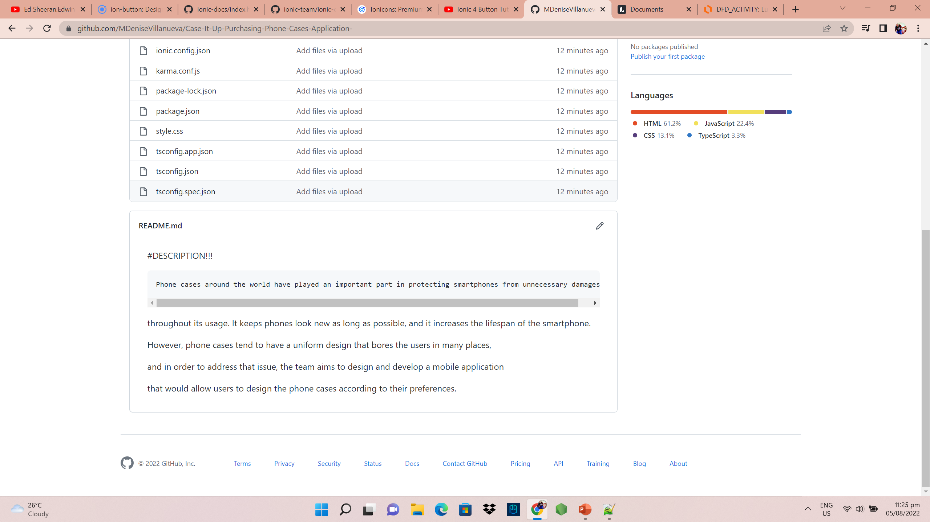
https://github.com/MDeniseVillanueva/Case-It-Up-Purchasing-Phone-Cases-Application-.git
GITLAB REPOSITORY
LINK

Slide 8

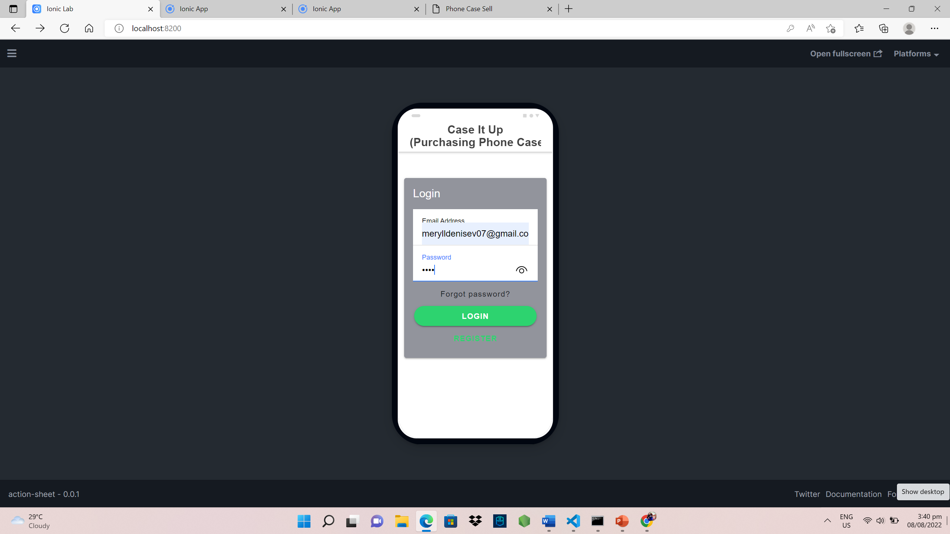
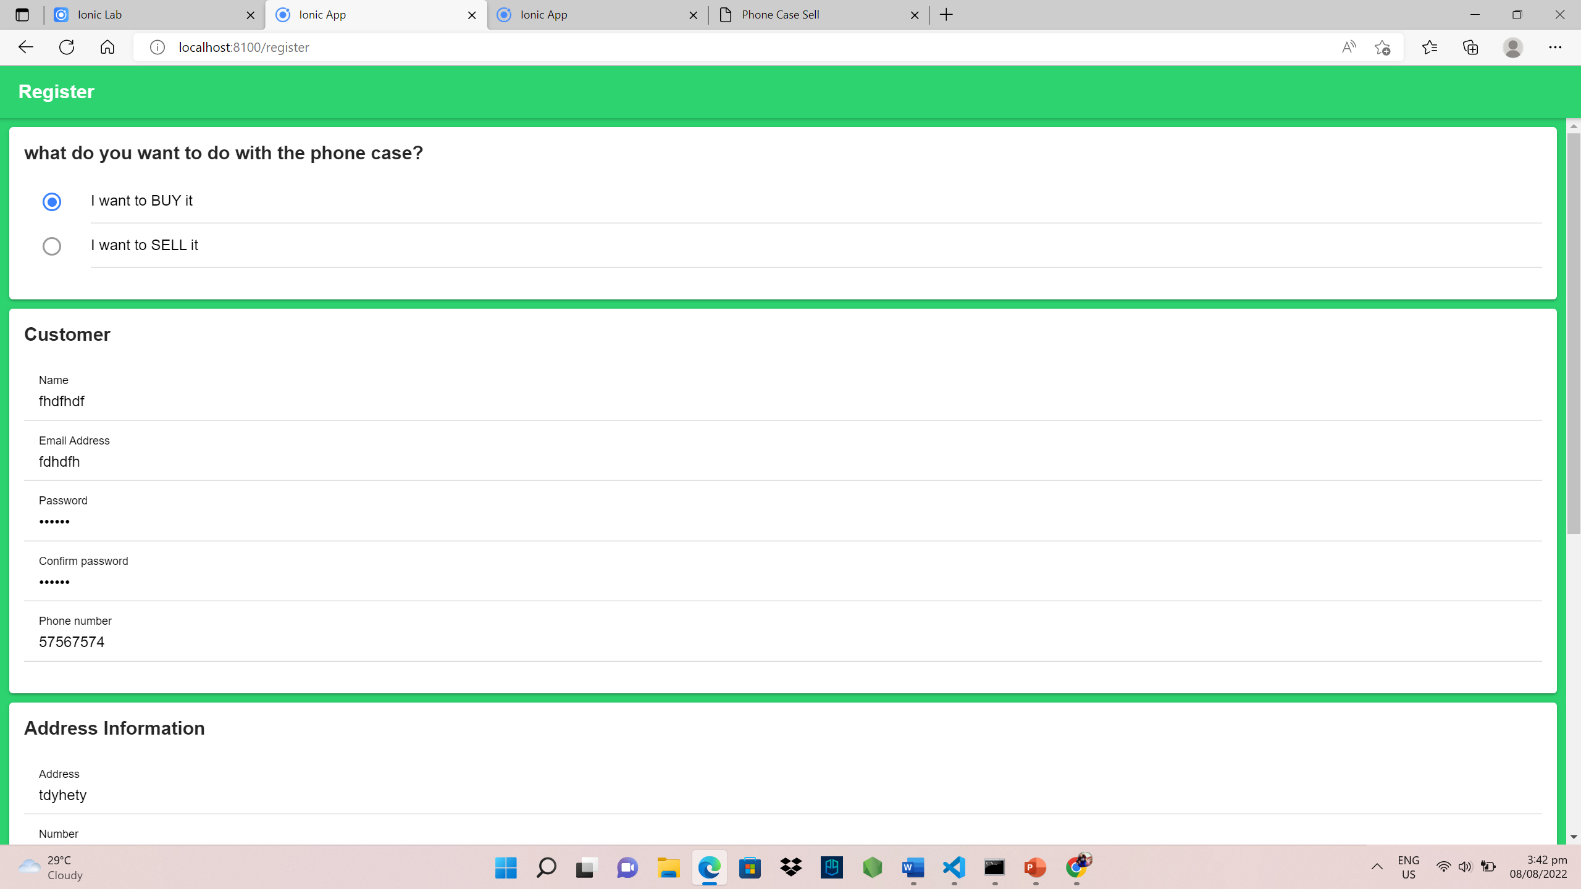
The login page
APPLICATION SCREENSHOTS
The registration page then after that it will go back to the login page to confirm your account

Slide 9
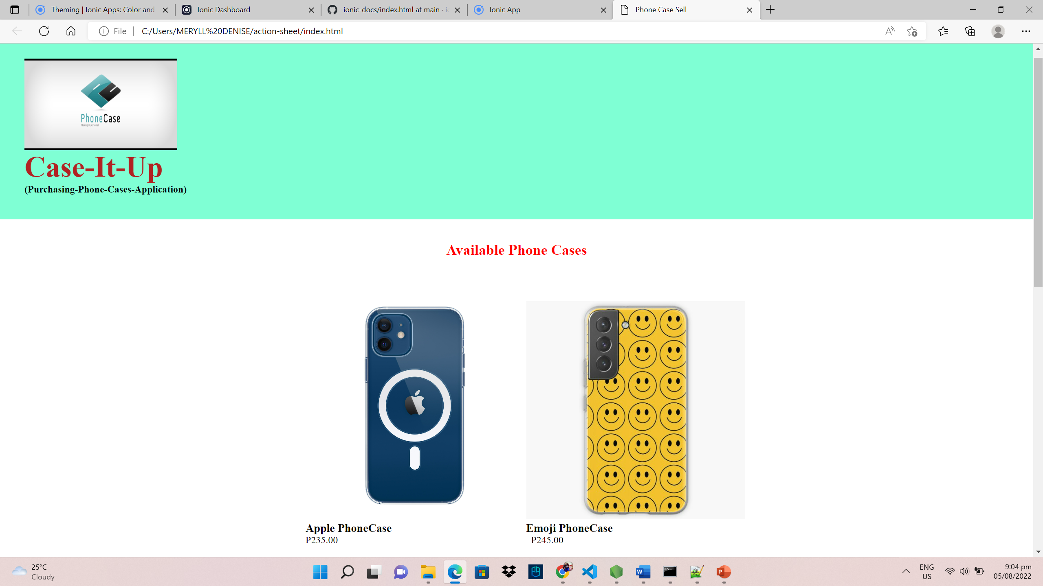
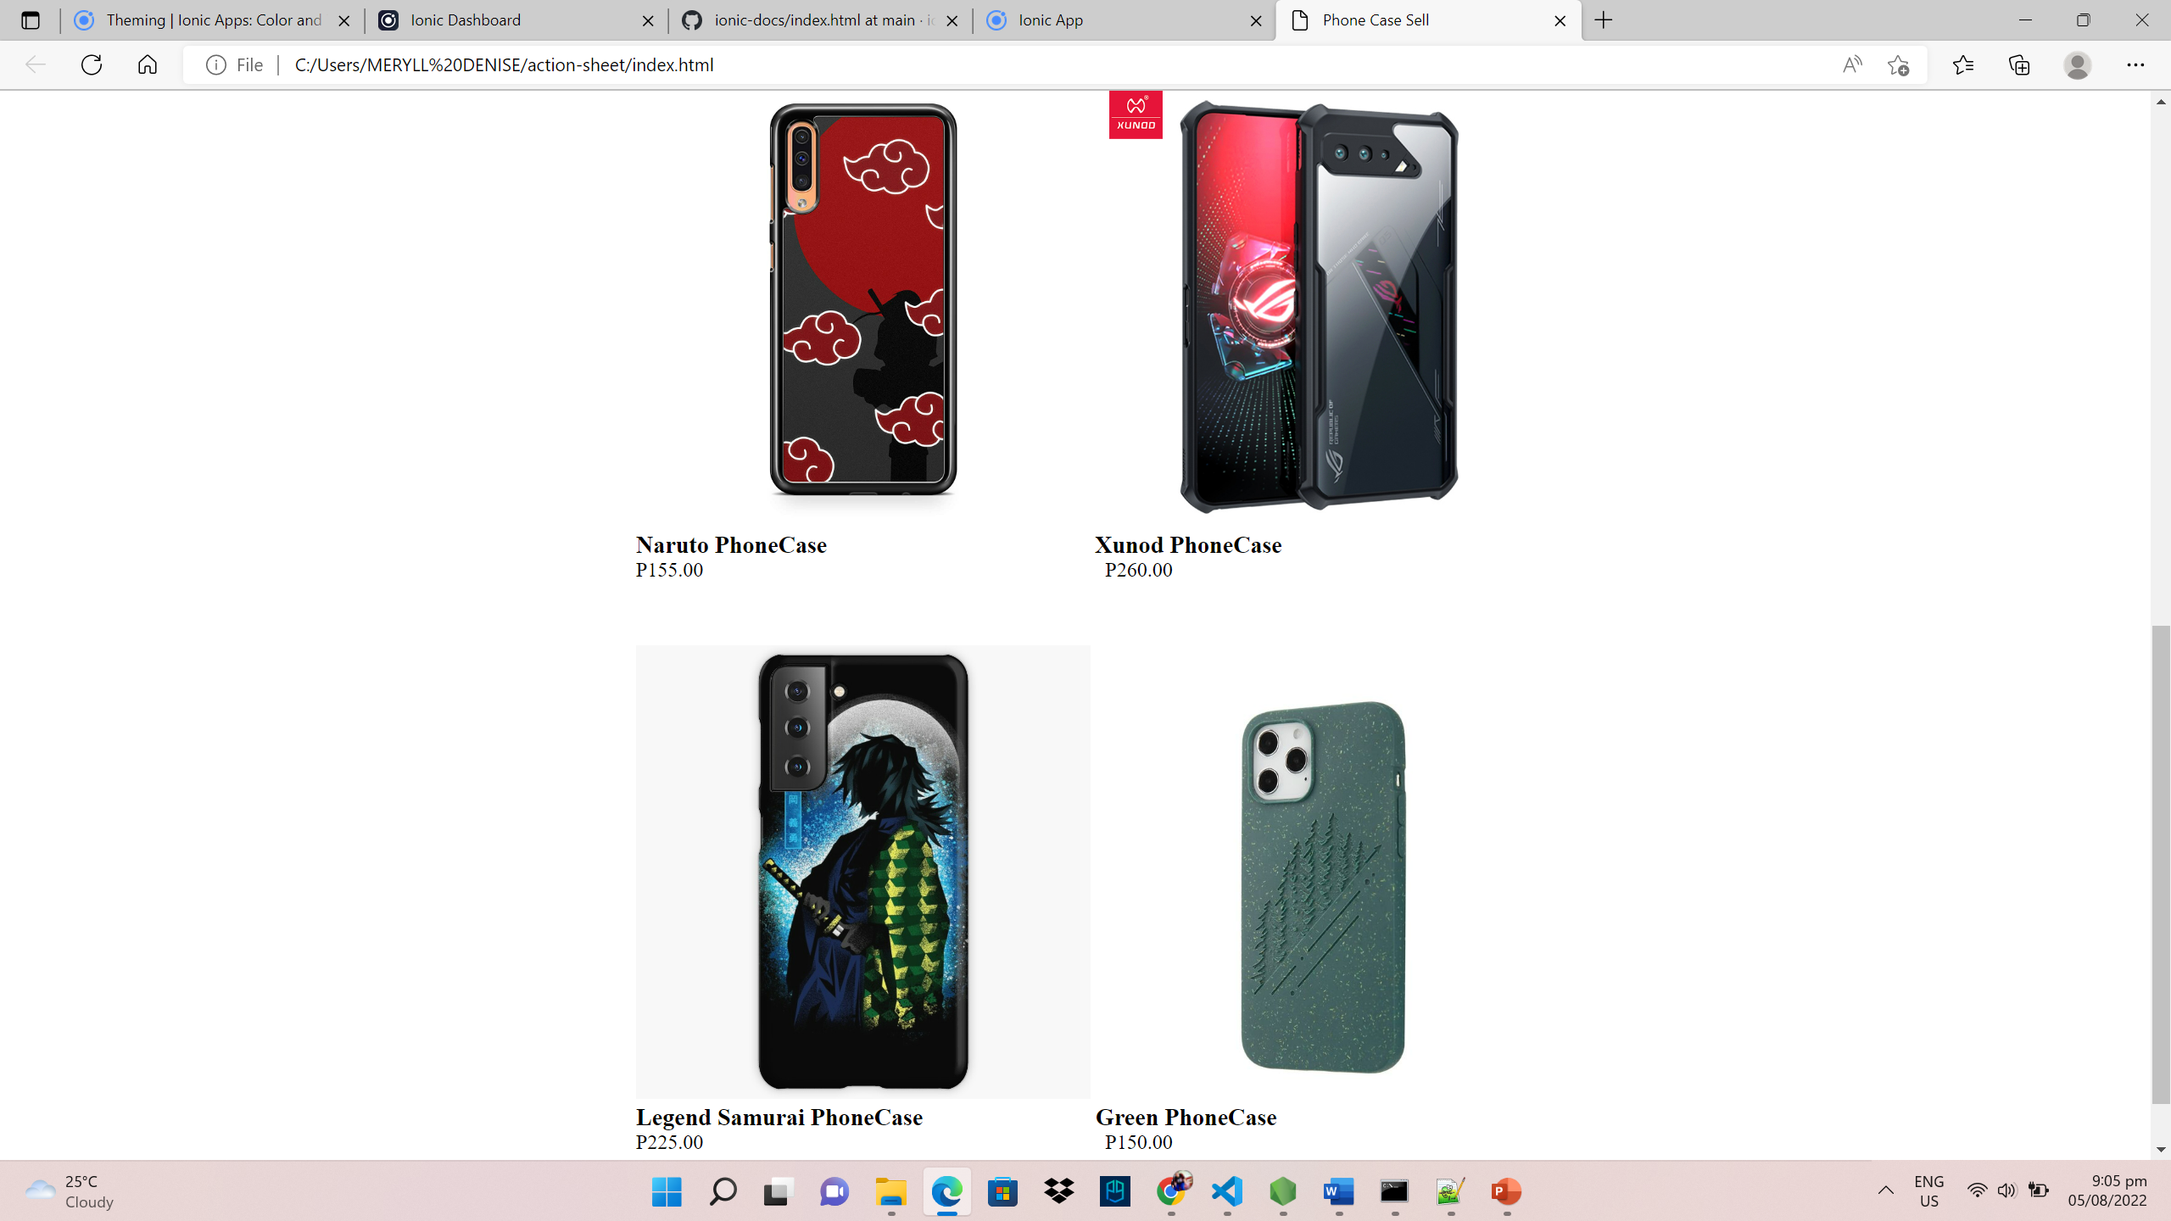
APPLICATION SCREENSHOTS
This is the purchasing page where you can choose your phone case you want to buy.

Slide 10
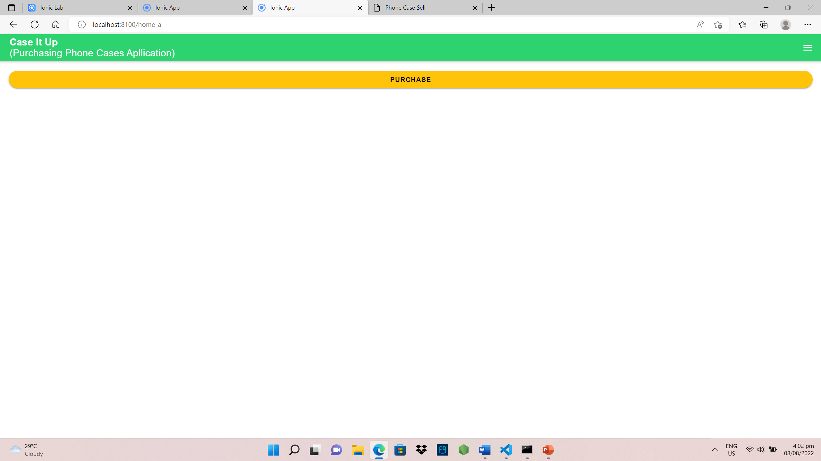
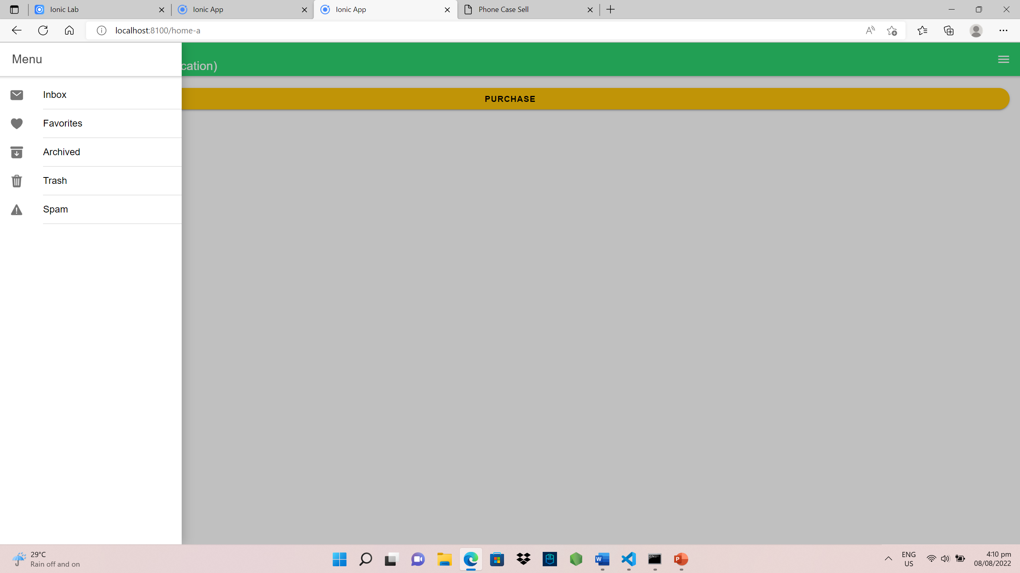
APPLICATION SCREENSHOTS
Then after you choose you can click the purchase button and it will go to the menu.
And to the menu you can see your inbox to check the confirmation message, and all the including buttons there.

Slide 11
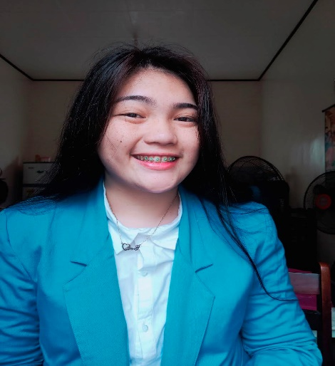
Villanueva, Meryll Denise C.
TEAM MEMBERS
Project Manager
Responsible for the complete project scope, the budget for the project, and the accomplishment or failure of the project also she help the programmer to program the application. And also she help the assign members to do the power point presentation.
Project Analyst
He supports only the project manager in overseeing the project.
Reyes, Allen Francis Z.
Programmer
He is the one who creates the source code for the proposed application. He also helps to the documentation. And he is the one who do more in coding.
Cacao, Bience Nico H.

Slide 12
TEAM MEMBERS
Designer
Responsible for the design of the mobile application, and he did not attend the meeting to present our application.
Garcia, Carlo
Documentation
Responsible for the creation of the document that goes along with the proposed application and that it answers the possible question about the software. And she is do the power point presentation with the help of other member nico and meryll.
Alapide, Rhea Mae D.

Slide 13
❤️ That’s all sir thank you ❤️

